Slide 1

Apache Cassandra

Slide 2
What is Cassandra?
Quoting from Wikipedia:
"Apache Cassandra is an open source distributed database management system designed to handle large amounts of data across many commodity servers, providing high availability with no single point of failure. Cassandra offers robust support for clusters spanning multiple datacenters, with asynchronous master less replication allowing low latency operations for all clients."
Notes:
In Hadoop was inside the dc however in Casandra is spanned across multiple dc
There is no master in Casandra . It make sure replication occure
Synchronous : system A sends a message to B receive it and forget it

Slide 3
Distributed Database
Data is split into multiple servers i.e. nodes in a cluster
The data in each node is itself replicated across multiple nodes
High Availability
Guaranteed data availability even in case of node failure/downtime
Effective replication mechanism providing no single point of failure
Can be scaled linearly simply by adding more machines/nodes to the cluster
Span Across Multiple Datacenters
Simple configurations required to extend scope to multiple datacenters

Slide 4
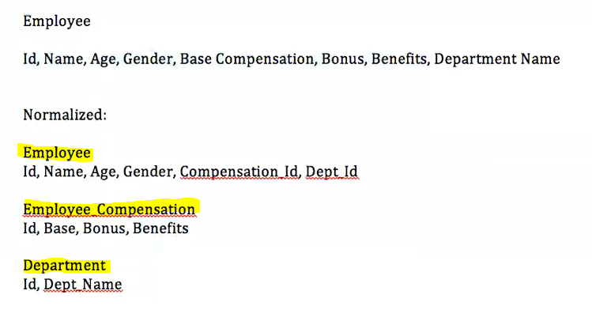
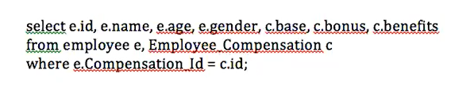
RDBMS -Normalization

Slide 5
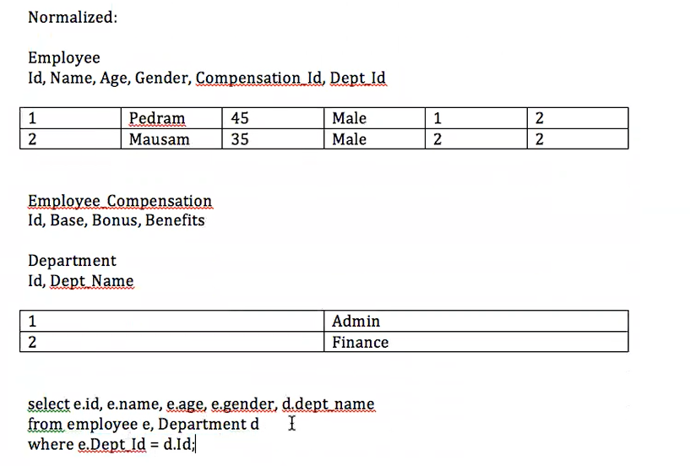
RDBMS -Normalization

Slide 6
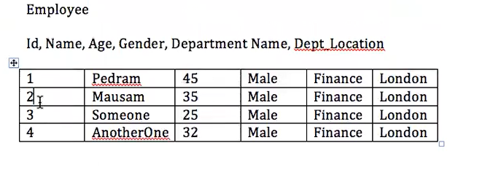
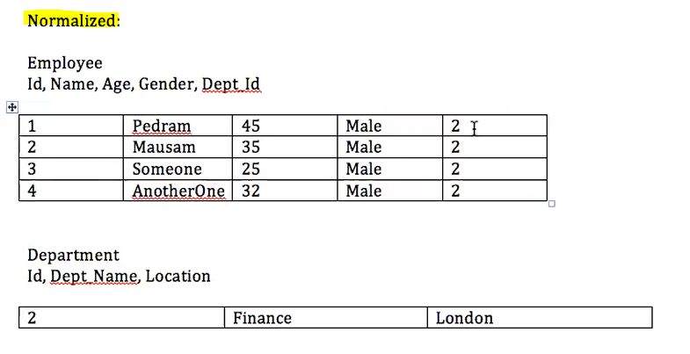
RDBMS –Denormalization (Cassandra)
Notes:
Normalized is more efficient in terms of space required
In terms of denormalization we do not have to do anything however in Normalization we split our data to different category
Make each table independent from others however if you want to link it make it as foreign key and make it primary key of another table
The purpose of normalization is to achieve redundancy.
======================================================================================================================================
Denormalization and duplication of data is a fact of life with Cassandra. Don't be afraid of it. Disk space is generally the cheapest resource (compared to CPU, memory, disk IOPs, or network), and Cassandra is architected around that fact. In order to get the most efficient reads, you often need to duplicate data.

Slide 7
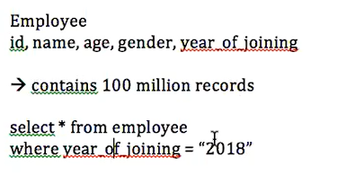
RDBMS - Challenges
Degraded performance under high data volumes
Expensive vertical & horizontal scaling
Sharding does solve some latency issues but that requires an additional layer of application code to track the shards
Sharding also makes backup and schema alteration difficult
Complex joins and normalized data adds too much of latency under high volume of data
Notes:
Sharding is a method of splitting and storing a single logical dataset in multiple databases.

Slide 8
CAP Theorem
MongoDB & HBase achieve CP
RDBMS’ achieve CA
Cassandra achieves AP
Consistency
Partition Tolerance
Availability
Notes:
How to choose different DB ?
The CAP Theorem states that all the 3 attributes cannot be met for a highly distributed system. A choice has to be met to achieve a balance of 2 out of these 3 attributes. RDBMS’ achieve CA. Cassandra achieves AP while MongoDB & HBase achieve CP.
Consistency : is when query the data you always receive the same data .(assume we do not update) .same data for employee
Availability : your data never ever lost
Partition tolerance: your data can be partitioned and stored as one single table something like Hive .We had partition directory then we did select * regardless of where the data is which give us all the data
Casandra is eventual consistent

Slide 9
Cassandra - Attributes
Cassandra
Distributed
Decentralized
Eventually Consistent
Fault Tolerant
Linearly Scalable
Column Oriented
Notes:
Distributed – The database spans across multiple nodes in a cluster
Decentralized – No master-slave cluster configuration. All nodes are equal.
Eventually Consistent – Cassandra is an AP system (see CAP Theorem). However, the database eventually corrects itself so that consistency is achieved over a period of time.
Fault Tolerant – Replication of data across nodes ensures fault tolerance
Linearly Scalable – Addition of nodes (horizontal scaling) has no effect on the performance of existing nodes.
Column Oriented – This is a column-oriented database. The user/application may add columns as it wants to, and each row can have a different set of columns (key-value pairs). It does not provide any relational integrity. It is up to the application developer to perform relation management.

Slide 10
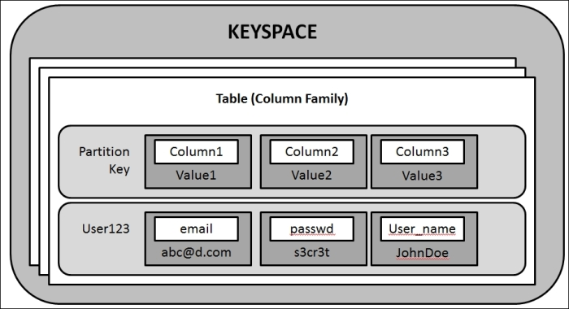
Cassandra Data Model
cells
Notes:
Keyspace is similar to DB .
Another name for Table is Column name .Each table has records (column name (email) and value(abc@d.com) )
Column 1 value 1 or Column 2 value 2 or Column 3 value 3 are cells
Cells are sorted by their names within a partition. (email first then passwd then username)
Cassandra does not support relations among tables to ensure high read performance. Hence data de-normalization is required.
Partitions are distributed across nodes in the cluster ensuring auto-sharding.

Slide 11
Keys
Key Types
Primary Key
Composite Key
Partition/Row Key
Clustering Key
Notes:
Key column is essentially is a column which uniquely identify the record. Sometimes is a column or combination of column .Primary key could be one column or multiple column .
Primary Key – Same as RDBMS primary key . One of the key column .Primary key could be a composite key (A primary key, also called a primary keyword, is a key in a relational database that is unique for each record. It is a unique identifier, such as a driver license number, telephone number (including area code), or vehicle identification number (VIN).)
Composite Key – Same as RDBMS composite key .(sometimes its not possible to identify your record .So in this case it is important to use combination of columns to uniquely identify the records.for example sometimes the department name and location become key column .
Partition/Row Key – The first column mentioned in the primary key acts as the partition key. Data is partitioned based on this key. All the data for a particular partition resides on the same node of the cluster. Composite partition key may also be specified while defining a table. Partition is a physical directory which data is stored.
Clustering Key – The remaining columns in the primary key act as the clustering key. This key determines how the data within a particular partition will be sorted.
If there is no more than one column then your primary and partition key are same.

Slide 12
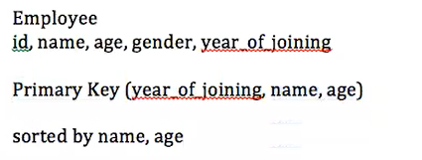
primary key : (Country, State, Population, GDP_PerCapita).
Within each country, the data is first sorted according to state, then according to population & finally according to GDP_PerCapita.
Partition key
primary key : ((Country, State), Population, GDP_PerCapita).
Partition key
Notes:
For example, if a primary key is (Country, State, Population, GDP_PerCapita), the data will be partitioned by Country. Each country’s data is guaranteed to reside on the same node, though replicas are present in the replica nodes. Within each country, the data is first sorted according to state, then according to population & finally according to GDP_PerCapita.
Also, to specify a composite partition key of Country & State, specify the primary key as ((Country, State), Population, GDP_PerCapita).

Slide 13
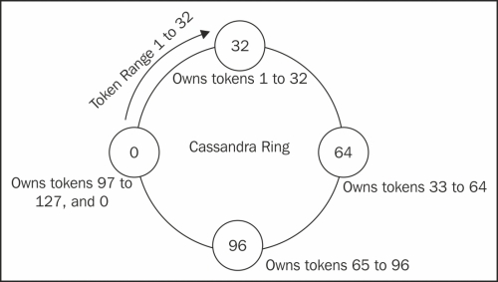
Casandra Architecture v1.1 or Earlier
Notes:
A token is respond to the particular partition
128 token = 128 years
Because the number of partition can be stored is 128
It puts 0-31 partitions in node 0
Each of these nodes has 32 partitions
=======================
Token – A token is the hash value of the row key
For each node in the cluster, an initial_token value had to be specified. That node contained all the tokens starting from the initial token + 1 of the previous node till its own initial token.
For example, if the partitioner algorithm used for the cluster can provide a maximum of 127 hash values, it implies that the cluster can have a maximum of 128 tokens (0 to 127). These token had to be manually distributed amongst the nodes of the cluster – equally if all nodes were intended to have equal load (usually if all machines are of equal capacity & power) or unequally if some machines were intended to handle more load than the rest.
The problem with this approach is that if a node fails or is removed from the cluster, its tokens had to be manually redistributed amongst the other live nodes within the cluster. Also, the data had to be streamed from the replica nodes onto the new replacement node when the replacement was added to the cluster. This created some overhead for the replica nodes during the streaming for the data restoration process.
-

Slide 14
Partition key → Year
Pedram, 46, Male, Laptop, 2016
Hash(2016) = 2016 % 128 = 96 (Token Id or partition ID)
Pedram, 46, Male, IPhone, 2016
Hash(2016) = 2016 % 128 = 96 (Token Id)
Pedram, 46, Male, PC, 2017
Hash(2017) = 2017 % 128 = 97 (Token Id)
===================================
Notes:
What practitioner does ? It’s the responsibility of the practitioner to make sure the data or the record goes to the right partition. In Casandra it goes in to the right node.
The node which client is connected to called coordinated node.
Casandra make sure all partitions get equal amount of storage or data (each partition should have same number of records (roughly)
Administrator assign the initial token for each node so it continue based on the initial token

Slide 15
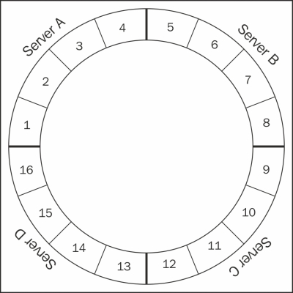
Casandra Architecture later than v1.1
Notes:
One significant difference between this version and v1.1 ? In this architecture there is noting called initial token we have num_token
Server A khows what is contained in Sever B ,C and D
===========================================
1. In this approach, the tokens have been replaced by a new terminology called virtual nodes. Each node has to specify the number of virtual nodes it can accommodate using the num_tokens property. The total number of virtual nodes of the cluster then becomes the total number of virtual nodes of all the physical nodes combined. Cassandra then assign the virtual nodes accordingly to each of the nodes. In case of a failure of a particular node, the virtual nodes of that physical node are immediately re-assigned equally to the other live physical nodes of the cluster. The data is also replicated to the other physical nodes based on the new assignment of the virtual nodes from the replica nodes of the dead node immediately. Thus, when a replacement node is added to the cluster, the load of data restoration is equally distributed amongst all the physical nodes of the cluster.

Slide 16
Partition key → Year
Pedram, 46, Male, Laptop, 2016
Hash(2016) = 2016 % 16 = 0 (Token Id) - goes to Server A
Pedram, 46, Male, IPhone, 2016
Hash(2016) = 2016 % 16 = 0 (Token Id) –goes to Server A
Pedram, 46, Male, PC, 2017
Hash(2017) = 2017 % 16 = 1 (Token Id) - goes to Server B
Pedram, 46, Male, PC, 2020
Hash(2020) = 2020 % 16 = 4 (Token Id) - goes to Server B

Slide 17
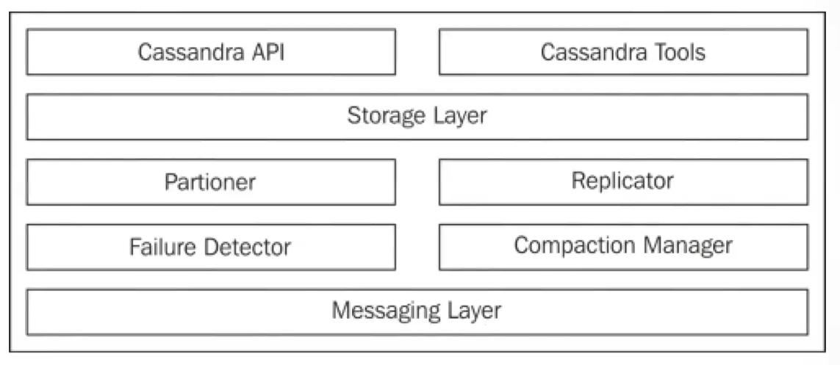
Components
Notes:
Casandra API : It’s API which use client and connects to Casandra
Set of component which used by client to connect to the node.
Casandra Tools : Set of tools that is provided by cluster administrator like HDFS Command we saw already
Storage layer or storage proxy : for storing data .A data can be stored in the same node or different node .It use partitioner to find out the data should be in the same node or different node (messaging layer ).
It communicate with messaging layer of that node
Replicator : use the replicator to store the replica in another node then the replicator use messaging layer to send a copy to another node
Failure detector and compaction manager : discuss later

Slide 18
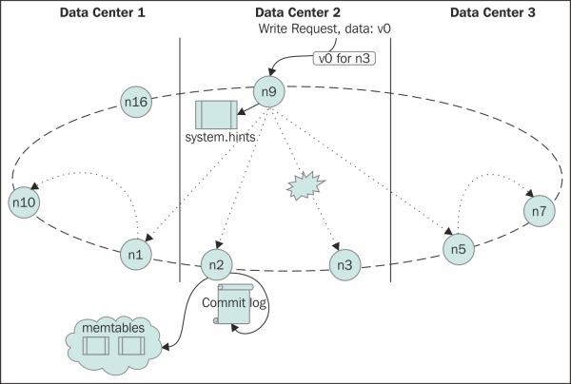
Write Operation
Notes:
When a write request arrives at the coordinator node, the Failure Detector checks to see if at least the number of replica nodes where the actual data is stored are available as per the Consistency value specified for the cluster. If not, it fails the write operation. If yes, the “StorageProxy” in the coordinator node sends the write requests to the individual data nodes. Note that, if some of the data nodes are there in a different data center, it does not send the write requests to all of them. It just sends the write request to one of them with a header in the message saying that the recipient node should forward the request to the other data nodes in the same datacenter. Also note that a Higher Consistency leads to a higher latency in write operations while a lower value compromises Consistency of the data within the database.
Once the request reaches the data node, the operation is first logged in the commit log. The data is then written to the MemTable, which is a Map of Maps stored in the memory. Once MemTables reach a threshold value, data from them is written to the SSTables. SSTables reside on the disk. Note that this way there could be numerous SSTables generated on the disk. Hence, a process called Compaction runs periodically that compact smaller the SSTable files into larger files on the disk . In case, the StorageProxy is unable to contact any of the individual data nodes for the write operation or the request it sent to the data node times out, it stores a local hint (system.hints) that it replays later to the node when it is reachable again so that the data is written on this node. This process is called Hinted Handoff.
=====================================================================================================================================
If write consistency is two it means data must written in two nodes.
N9 is coordinator. My partitioner says the data should go to n1,n2,n3,n5,.These are the replica
It should go to n1 and n2,n3,n5,. Are replica. Right consistency : it’s a number for example .if the data can not be written to 2 replica then write operation must fail. The replication factor is 4 .SO replica find out the nodes n1,n2,n3 and n4 are the replica and using failure detector how many such nodes are currently alive where the replica must go .Failure detector has to make sure 2 out of 4 nodes are alive. Once the failure detector does not return true .It means it sends a message to n9 that I do not have enough nodes in right consistency . failure detector sends a signal to storage layer .and storage layer sends to Api and API sends to the client and says your operation failed.
==========================================================================================================================================
The higher the right consistency the higher latency so it takes more time to reach out to those many nodes
The commit log is basically is a log .mem table : map of map (slide 10) : in memory table
Mem table has threshold .two threshold .time and value .when threshold is reach it will flash to the disk called ss table
Compaction manager : combine all the ss table and combine it to one file then delete the smaller one . Because the more file the more time to read .(one file needs to be read so less time ) .More SS table means more files.

Slide 19
Read Operation
When a read request comes to the coordinator node, the following events occur:
The coordinator node uses the Snitch mechanism to determine the closest data node.
It sends the request for data to the closest data node.
Based on the configured read Consistency, it requests the other closest nodes for the data digest (hash of the data to be returned).
If the digests of the data returned by the closest node and the other nodes match, the data is returned to the client.
If there is a conflict in the digests, data from all the conflicting nodes is pulled by the coordinator node and the latest amongst them is returned to the client. Then the nodes that are not in sync with the latest data are updated with the latest data.
Now, if read repair is enabled, any node that have not yet been touched yet that have a replica of the data pointed to by the row key is asked for the digest of the data. All nodes for which the digest does not match are updated with the latest data in the background.
Notes:
Read consistency is 3 and replication factor is 6 so it fetched the data from other two closest nodes n3 . N2 gives the actual data
and n5 n3 and n5 gives the hashes value if the has value are same then it will send the data to client
==================================================================

Slide 20
Read Operation – Node Specific
When a read request comes to a node, Cassandra first looks up the MemTable to see if the data is present in it. If yes, it is returned to the coordinator node. If not, it uses the bloom filter (built on the row keys contained in the SSTable) associated with each SSTable to find a set of SSTables where the data may reside.
Now, it scans each SSTable in reverse chronological order (latest first, oldest last). Each row in the SSTable, in turn, has a bloom filter associated with it. Each SSTable also has an index associated with it. Cassandra uses the bloom filter to see if the row may contain the column value requested. When combined with the index it actually locates the value associated with that column. This value id returned to the coordinator node. The other SSTable next in the set are ignored because they have a later timestamp.
Notes:
Bloom filter is a data structure which give you a false positive result .false positive is Boolean .
If it returns false it means the data is not in that SSTable .If it says true the data may or may not in the SSTable .so out of 100 ,90 is eliminated .

Slide 21
Seed Node
Seed nodes are specially designated nodes within the Cassandra cluster. When a new node joins the cluster, it “gossips” with the seed node to become a part of the cluster like other existing nodes. A cluster should have more than one seed node but all nodes should not be seed nodes. They are not special is any other way. They are neither the master in a master-slave configuration.
They (0)sends out meta data to the right (32) and left nodes (96).
Notes:
They (0)sends out meta data to the right (32) and left nodes (96).
Node (32) sends out meta data to the right 64) + meta data it receives from (0) and left nodes 0).
Node (64) sends out meta data to the right (32) + and left nodes (96) + meta data it receives from (0) and (32)
……

Slide 22
Snitches
SimpleSnitch: A closer node is the one that comes first when moving clockwise in the ring.(It should have the replica)
PropertyFileSnitch: This snitch allows you to specify how you want your machines' location to be interpreted by Cassandra. You do this by assigning a data center name and rack name for all the machines in the cluster in the $CASSANDRA_HOME/conf/cassandra-topology.properties file. Each node has a copy of this file and you need to alter this file each time you add or remove a node.
GossipingPropertyFileSnitch: Similar to PropertyFileSnitch, you have a file called $CASSANDRA_HOME/conf/cassandra-rackdc.properties, and in this file you specify the data center and the rack name for that machine. The gossip protocol makes sure that this information gets spread to all the nodes in the cluster.
RackInferringSnitch: This snitch infers the location of a node based on its IP address. It uses the third octet to infer rack name, and the second octet to assign data center.
EC2Snitch: This is meant for Cassandra deployments on Amazon EC2 service. EC2 has regions and within regions, there are availability zones.
EC2MultiRegionSnitch: The multi-region snitch is just an extension of EC2Snitch where data centers and racks are inferred the same way. But you need to make sure that broadcast_address is set to the public IP provided by EC2 and seed nodes must be specified using their public IPs so that inter-data center communication can be done.
DynamicSnitch: This Snitch determines closeness based on a recent performance delivered by a node. So, a quick responding node is perceived as being closer than a slower one, irrespective of its location closeness, or closeness in the ring. This is done to avoid overloading a slow performing node. DynamicSnitch is used by all the other snitches by default. You can disable it, but it is not advisable.
Notes:
GossipingPropertyFileSnitch is same as PropertyFileSnitch . PropertyFileSnitch is more static which you have to update the file manually every time a node join a cluster
In GossipingPropertyFileSnitch you update once then The gossip protocol makes sure that this information gets spread to all the nodes in the cluster
DynamicSnitch does not work in EC2

Slide 23
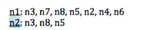
PropertyFileSnitch:
$CASSANDRA_HOME/conf/cassandra-topology.properties file
Notes:
Node n1 closest nodes are : n3,n7,n8,n5,n2,n4,n6
Node n2 closest nodes are : n3 ,n8 and n5

Slide 24
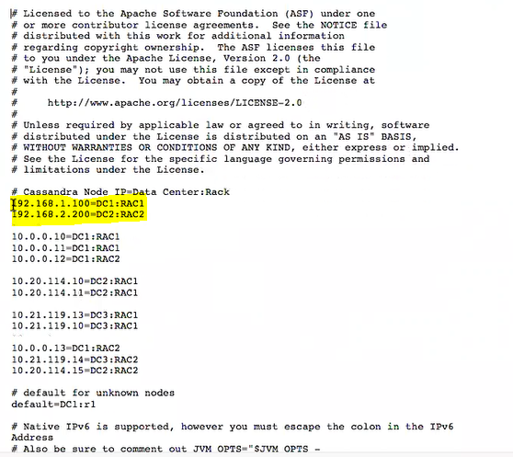
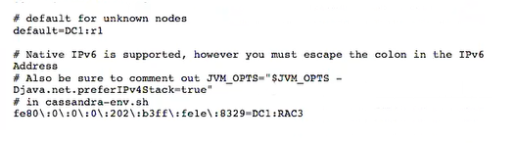
PropertyFileSnitch:

Slide 25
Partitioner
Murmur3Partitioner
Calculates the Murmur hash of the row keys and distributes the data accordingly.
RandomPartitioner
Uses the MD5 hashing algorithm to distribute data across the cluster.
ByteOrderPartitioner
Generates tokens for row keys that are in the order of hexadecimal representations of the key
Cassandra 1.1.x and precursors have this as the default partitioner.
This is an ordered distribution, so the rows are stored in lexical order.
Notes:
RandomPartitioner : old version
Murmur3Partitioner : current version
ByteOrderPartitioner : rarely is used
lexical order, dictionary order, alphabetical order or lexicographic(al) product) is a generalization of the way words are alphabetically ordered based on the alphabetical order of their component letters.

Slide 26
Tunable Consistency
Consistency | Write | Read
Zero | Fire & Forget | Not available
Any | Any of the designated nodes | Not available
One | First replica | First replica
Quorum | N/2 +1 replicas | N/2 +1 replicas
All | All replicas | All replicas
* N = Replication factor configured for the cluster
Notes:
Quorum is the most balanced one .
When you send write or read request then you specify these values in consistency.

Slide 27
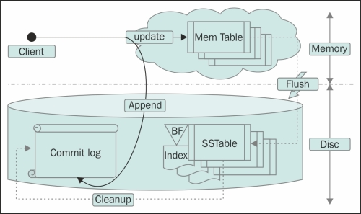
Commit Log
Notes:
When a node fails (When a node write data to another node it sends to commit log first then it write it in the MemTable
Commit log = Mem table + SSTable
Imagine that I have 10 records in commit log in which 6 of them is written in SSTable and the rest are in MemTable .Node will fail, and we lose the MemTable so at this point the commit log
is iterated in ascending (according to timestamp) fashion) ,

Slide 28
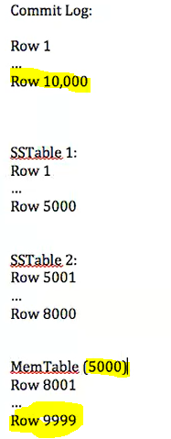
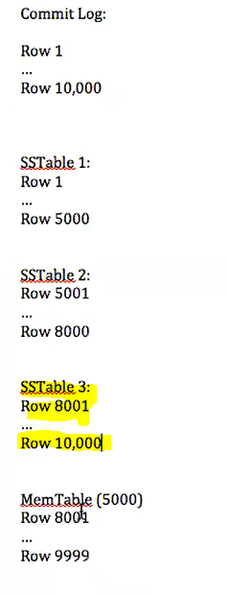
Notes:
Row 10000 came but only row 9999 is written to MemTable then node fails.
So it writes that in the new SSTable .Even 10,000 is not written in MemTable I will write it there in SSTable 3 (commit log is sorted) .The moment the data comes to the commit log it does not matter it went to the MemTable or not.
Whatever is in the comm log will be restored and the MemTable does not matter any more.
the following operations are performed by Cassandra to restore the lost data:
The commit log is iterated in ascending (according to timestamp) fashion
The lowest Replay Position, which signifies the last point in the commit log that was written successfully to the SSTable, is chosen
If the Replay Position for the table is less than any of the recorded Replay position in the commit log, the log is replayed to the MemTable
All MemTables that have been replayed data from the log are forcefully written to the SSTables
The commit logs are discarded
===================================================================================================
Commit log is all data comes to that particular partition
Eventual consistent : when you request data from Casandra it may or may not give you the right data .eventually it will be consistent

Slide 29
Data Write Sequence
Commit Log
MemTable
SSTable

Slide 30
SSTable
SSTable
Bloom Filter
Index File
Data File
Notes:
Bloom Filter – A bit-vector based data structure that returns false-positives i.e. says that the data may be present or not at all present in the SSTable associated with the filter. There is 1 bloom filter (based on the row key) per SSTable and 1 bloom filter (based on the column names) per row.
Index File – Contains the offset of each row in the data file. There is 1 index file per SSTable.
Data File – Contains the row key, columns and metadata for the SSTable.
Bloom Filter brings down the amount of table to be scanned. The search is more efficient

Slide 31
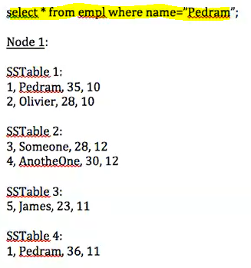
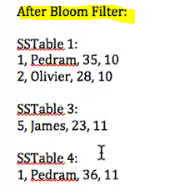
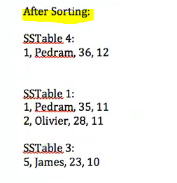
Now after sorting each SSTable will be scanned(index)
Notes:
Now after sorting each SSTable will be scanned

Slide 32
Compaction
Process of merging multiple SSTable files into a single larger file
Two types of compaction strategies are provided out of the box – size tiered and level strategy
Compaction thread is triggered when a certain threshold (configured) is reached

Slide 33
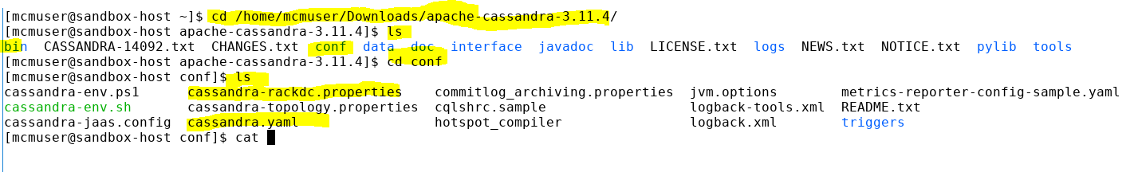

Slide 34
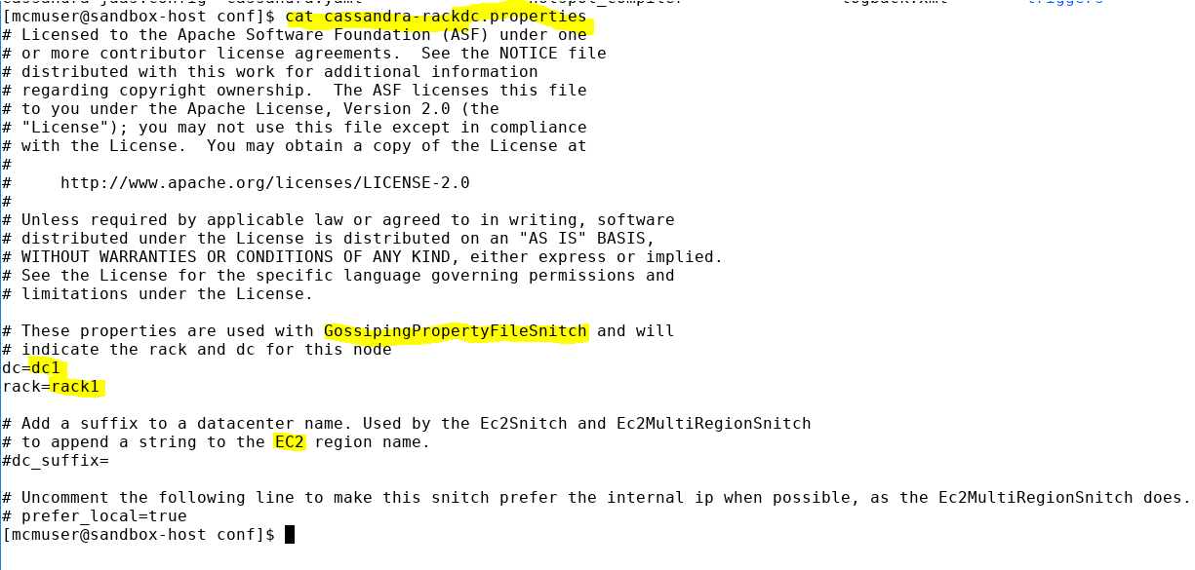

Slide 35
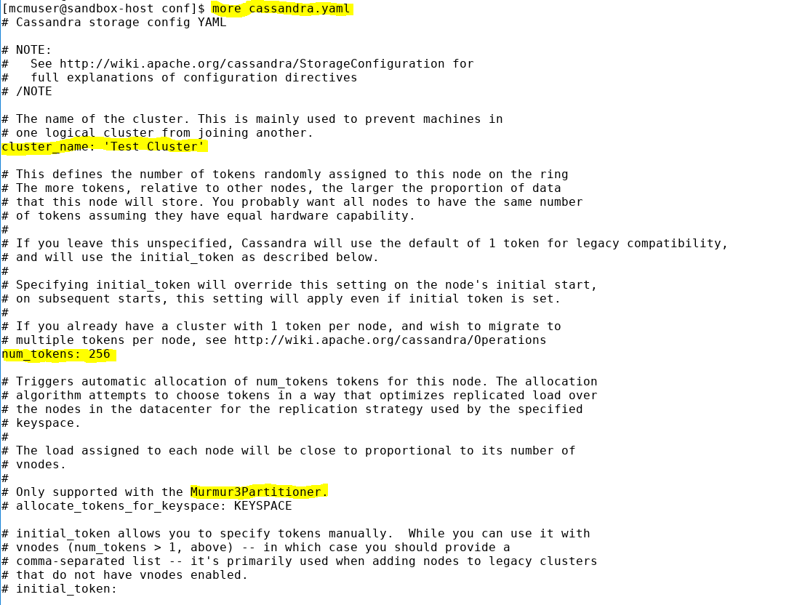

Slide 36
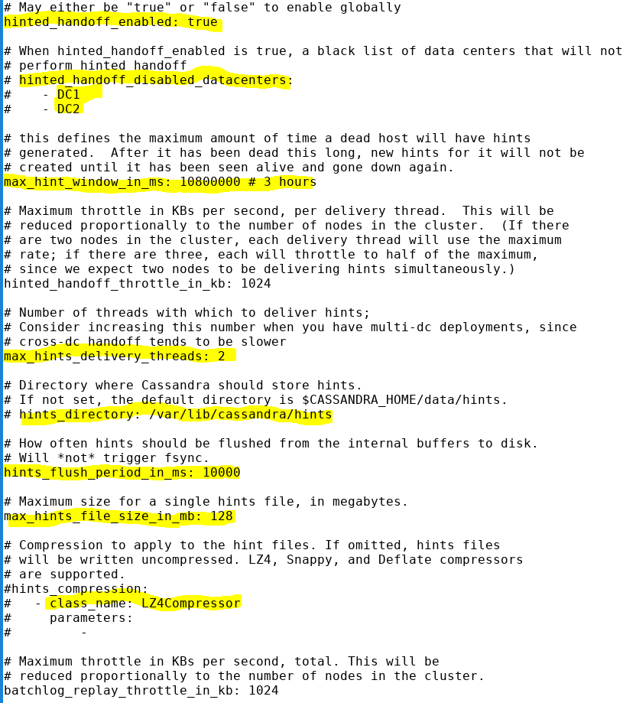

Slide 37
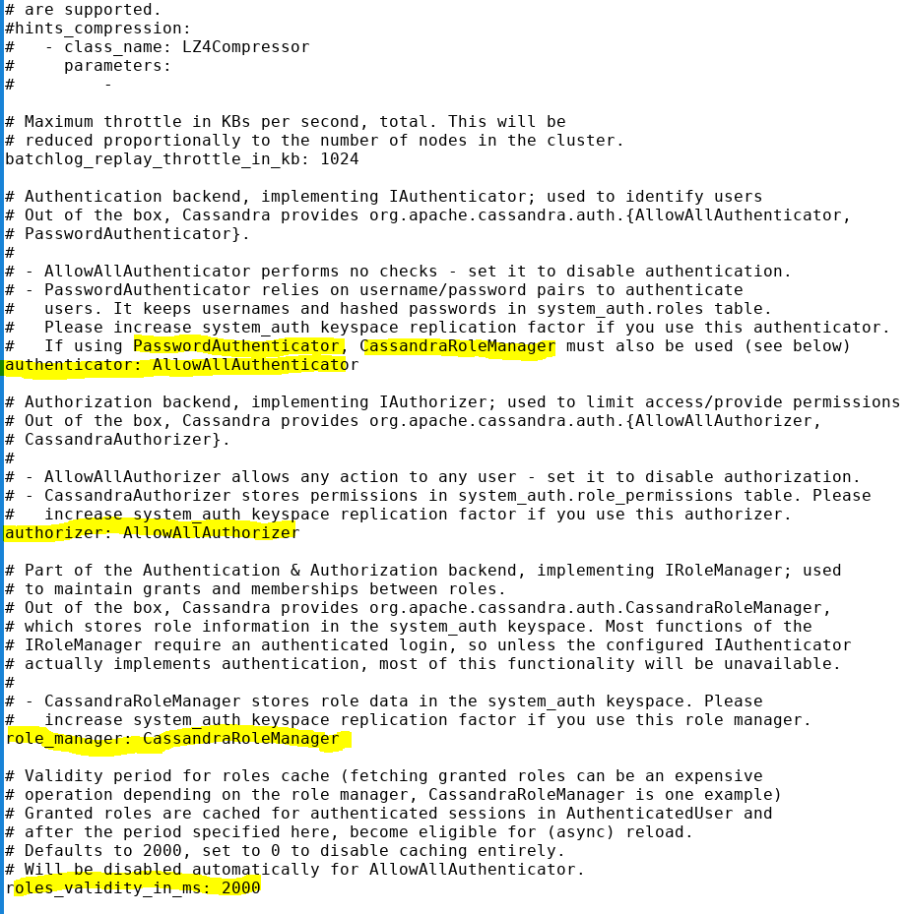

Slide 38
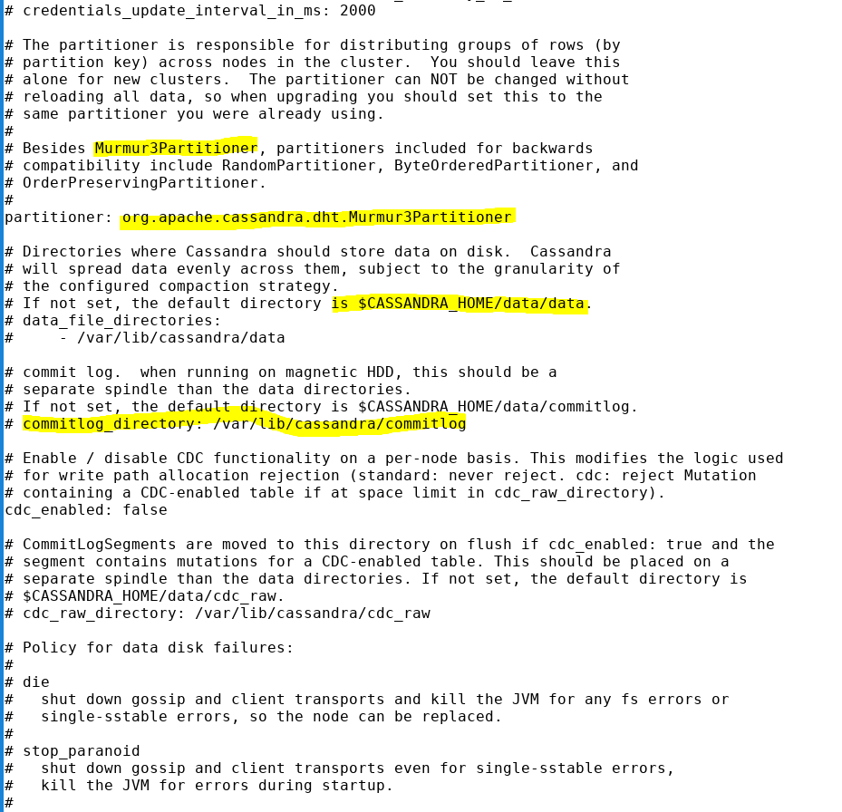
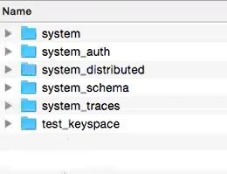
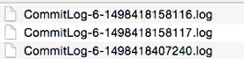

Slide 39
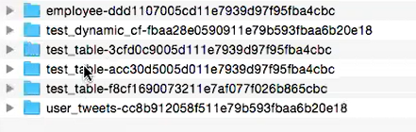
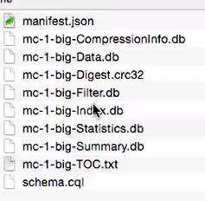
DB
Table
Data
Notes:
Data

Slide 40
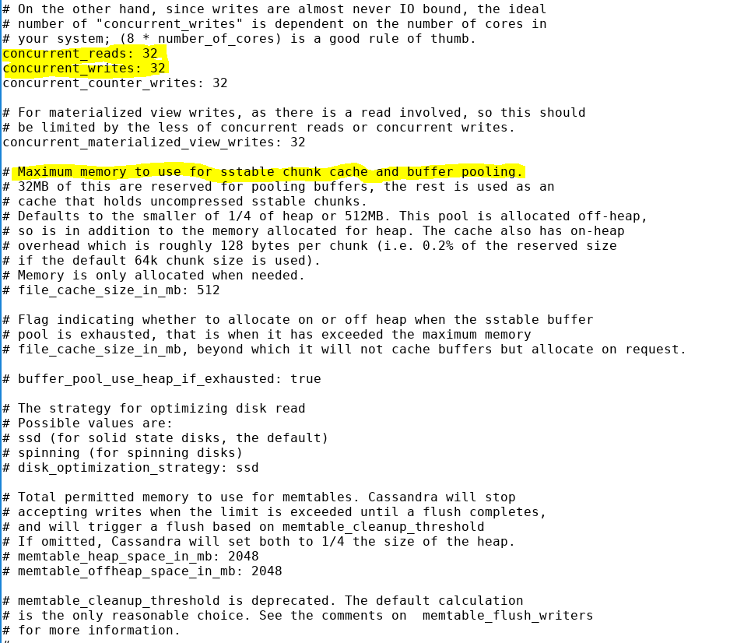

Slide 41
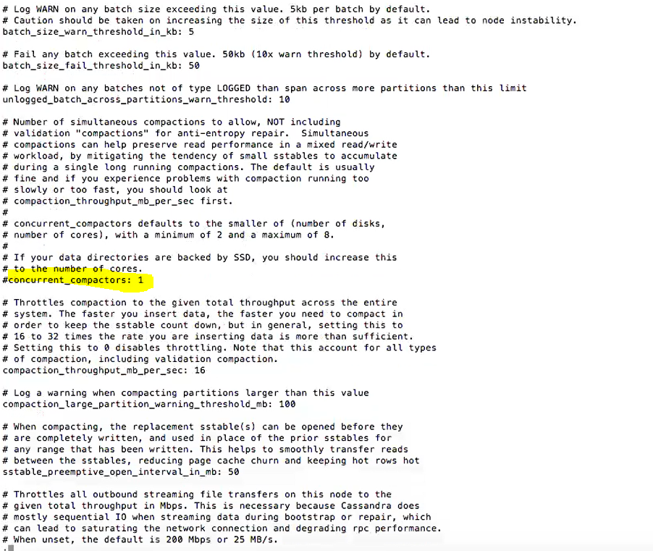

Slide 42
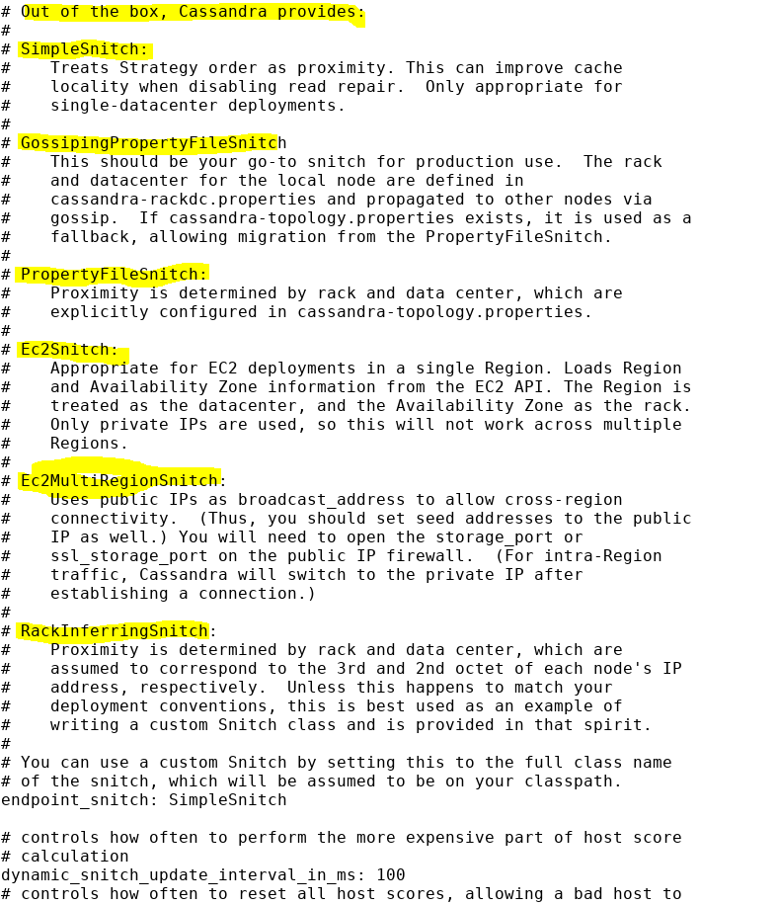

Slide 43
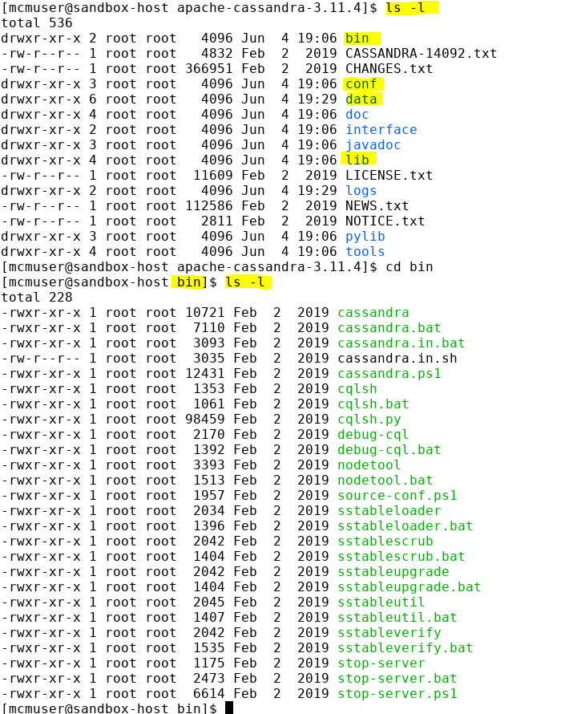

Slide 44
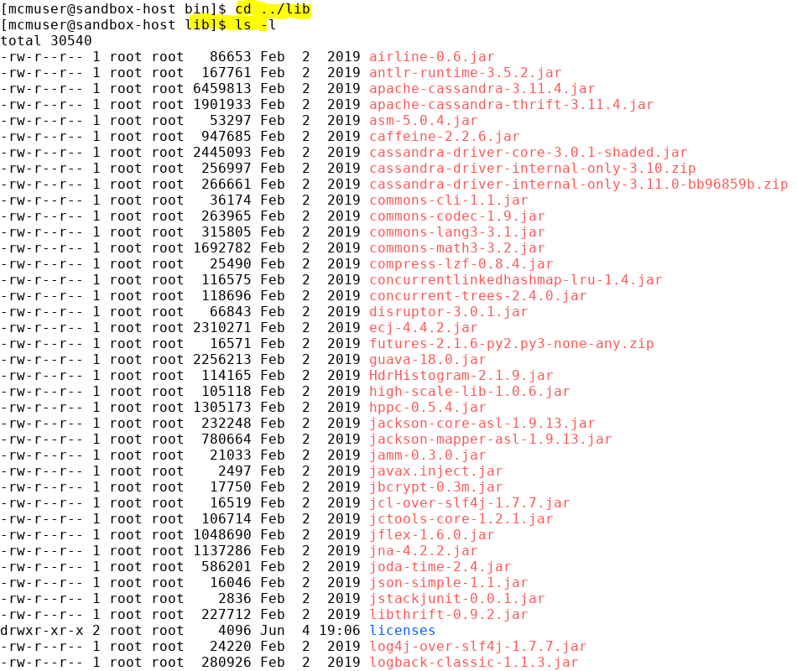
Every time you write your own partitioner you need to package it to jar and put It in lib directory

Slide 45
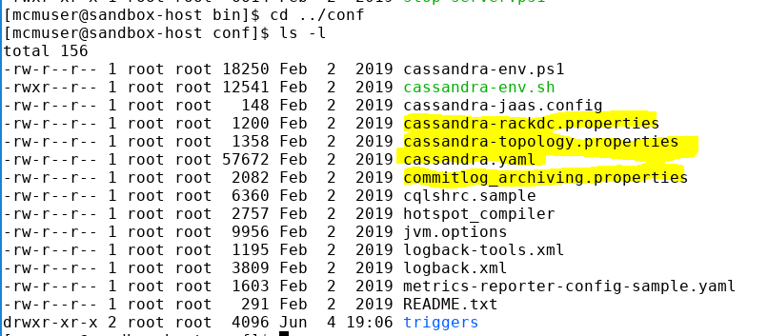

Slide 46
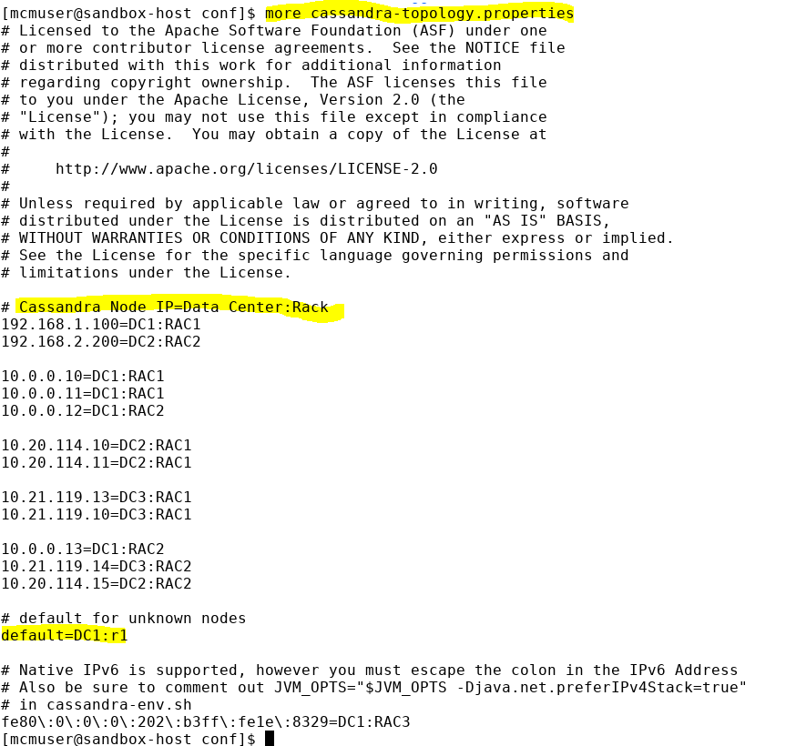

Slide 47
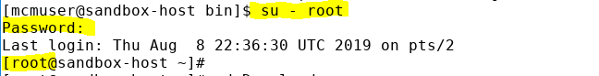
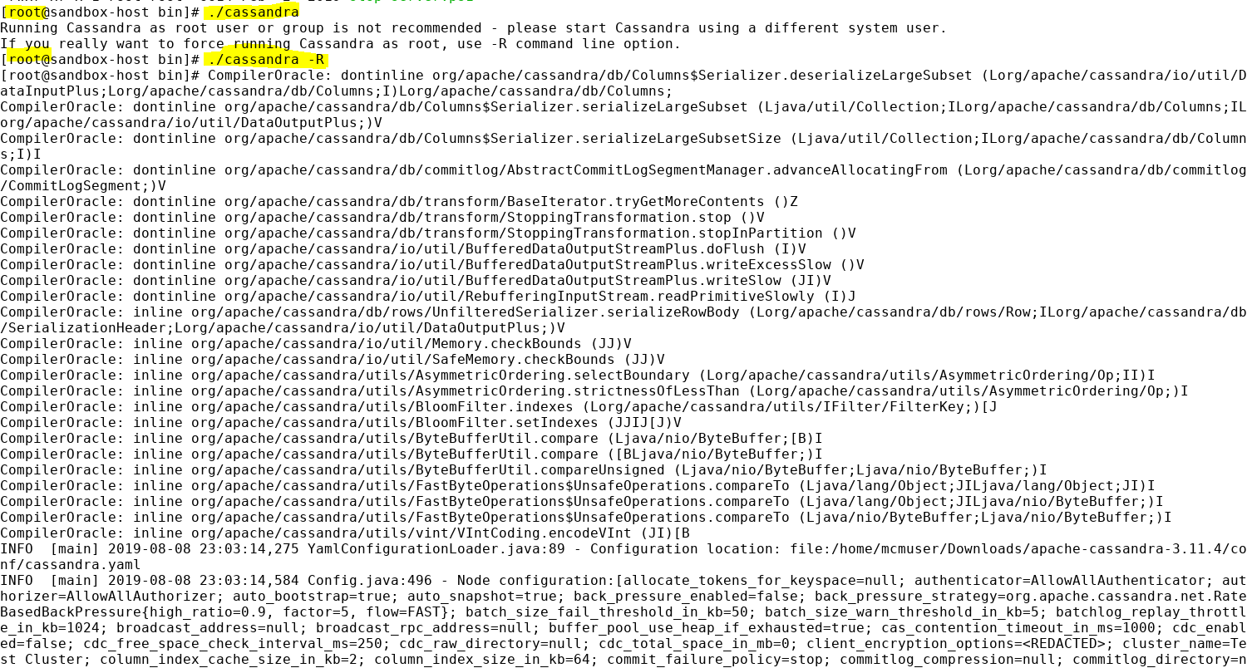

Slide 48
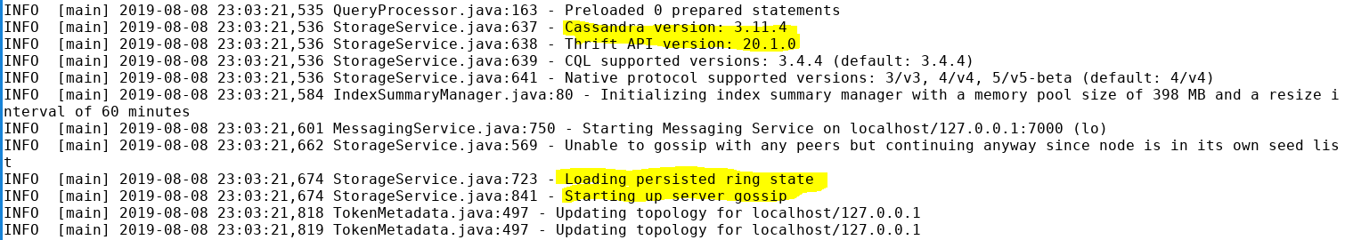
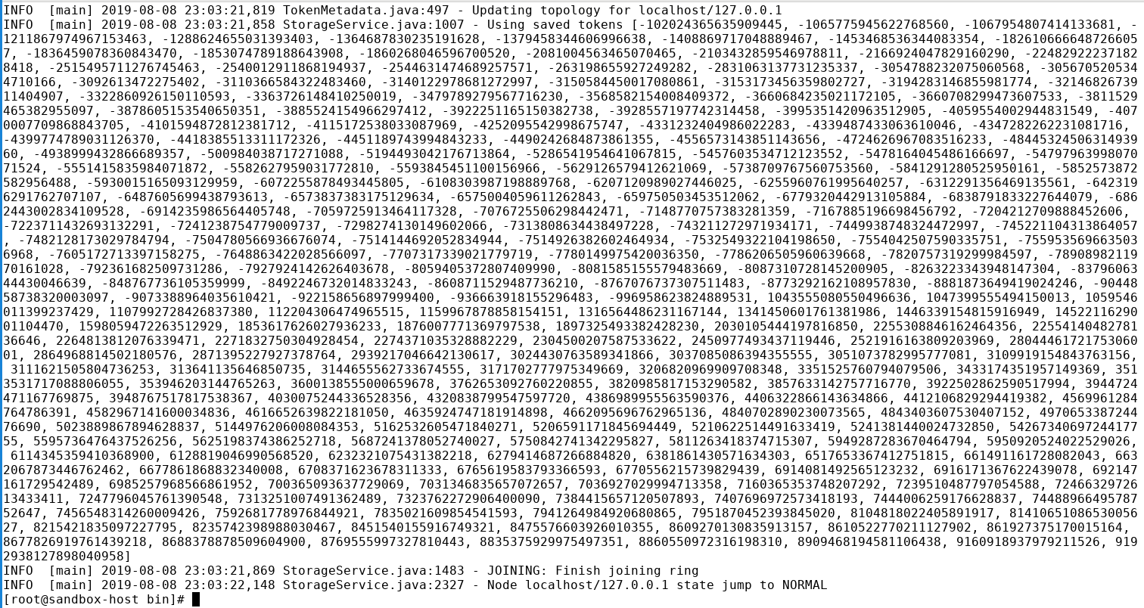

Slide 49
Notes:
When you see “state jump to NORMAL” means you have started the Cassandra successfully otherwise follow the error and troubleshoot

Slide 50
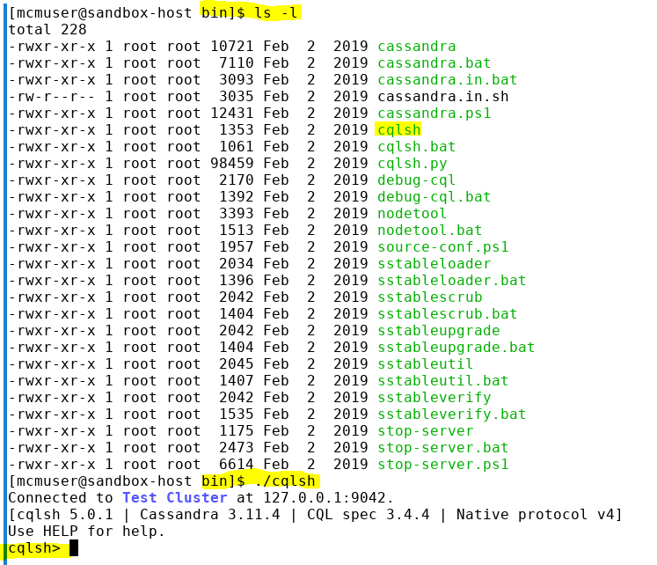

Slide 51
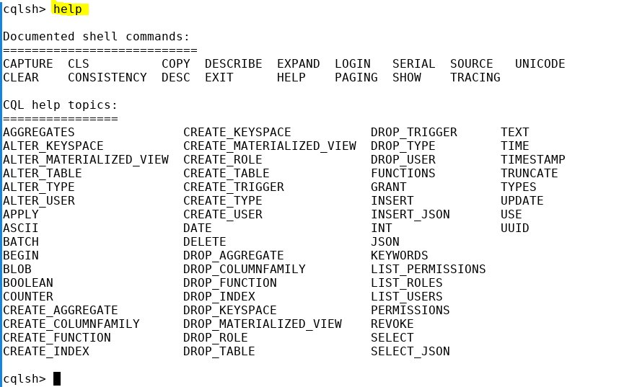

Slide 52
Keyspaces
Logical container for tables
Similar to databases in RDBMS
Holds global properties like replication factor, replica placement strategy etc.

Slide 53
Replication Strategy
Simple Strategy
Used when all nodes are in the same data center
Data replica is placed on the next node(s) going clockwise in the ring
Network Topology Strategy
Mainly used when nodes span across multiple data centers
Follows rack awareness within a data center
Replication factor must be a positive integer
Data center specific replication factor can be specified
Notes:
Simple Strategy:
Format: { 'class' : 'SimpleStrategy', 'replication_factor' : <positive_integer> }
Network Topology Strategy:
Format: { 'class' : 'NetworkTopologyStrategy'[, '<datacenter_name>' : <positive_integer>, '<datacenter_name>' : <positive_integer>, ...] }
Example:
# Single data center, replication factor: 3
{ 'class' : 'NetworkTopologyStrategy', 'DC1' : 3}
# Three data centers, with RF as 3, 2, and 1
{ 'class' : 'NetworkTopologyStrategy', 'DC_NY' : 3, 'TokyoDC' : 2, 'DC_Hadoop': 1}
# Two data centers with three replica each
{ 'class' : 'NetworkTopologyStrategy', 'DC1' : 3, 'DC2' : 3}

Slide 54
Example
Simple Strategy:
Format: { 'class' : 'SimpleStrategy', 'replication_factor' : <positive_integer> }
Network Topology Strategy:
Format: { 'class' : 'NetworkTopologyStrategy'[, '<datacenter_name>' : <positive_integer>, '<datacenter_name>' : <positive_integer>, ...] }
Example:
# Single data center, replication factor: 3
{ 'class' : 'NetworkTopologyStrategy', 'DC1' : 3}
# Three data centers, with RF as 3, 2, and 1
{ 'class' : 'NetworkTopologyStrategy', 'DC_NY' : 3, 'TokyoDC' : 2, 'DC_Hadoop': 1}
# Two data centers with three replica each
{ 'class' : 'NetworkTopologyStrategy', 'DC1' : 3, 'DC2' : 3}
Notes:
NetworkTopologyStrategy follow rack awareness ( Cassandra or Hadoop will try to make sure at least one copy of data in another rack)

Slide 55
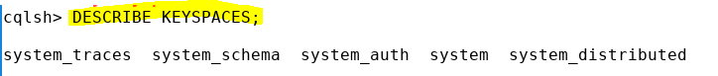
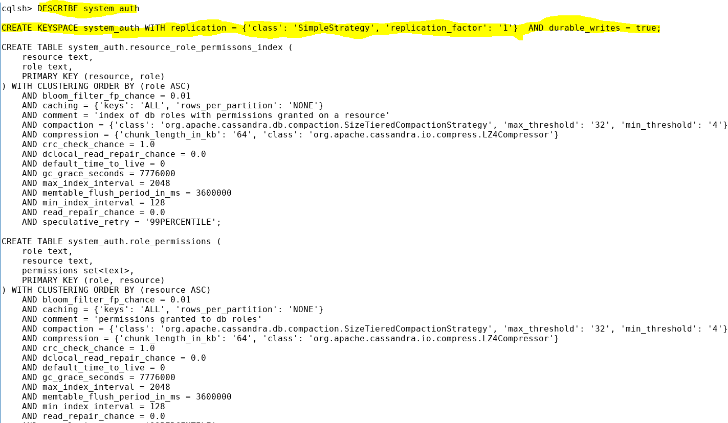
commit log
In Cassandra tables are not replicated .keyspaces are replicated
Notes:
Keyspaces are db
in Cassandra tables are not replicated .keyspaces are replicated .when keyspaces are replicated it follows a strategy . That strategy follow a class name
We have to say within the data center how many copies we want .Cassandra supports cross data center replication
Durable write : true : enable commit log writing. false : disable commit log writing .
If the node crashes the commit log will help to retrieve the data (if durable_ write is true) .if its false then the read and write will be faster but if the node fail then you can not retrieve it.

Slide 56
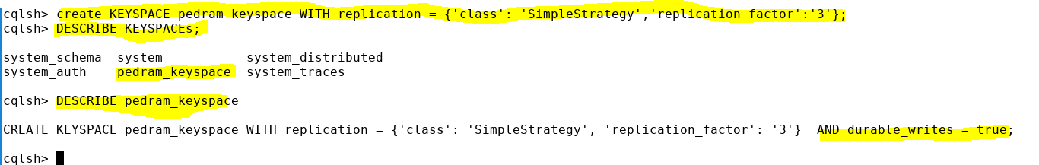

Slide 57
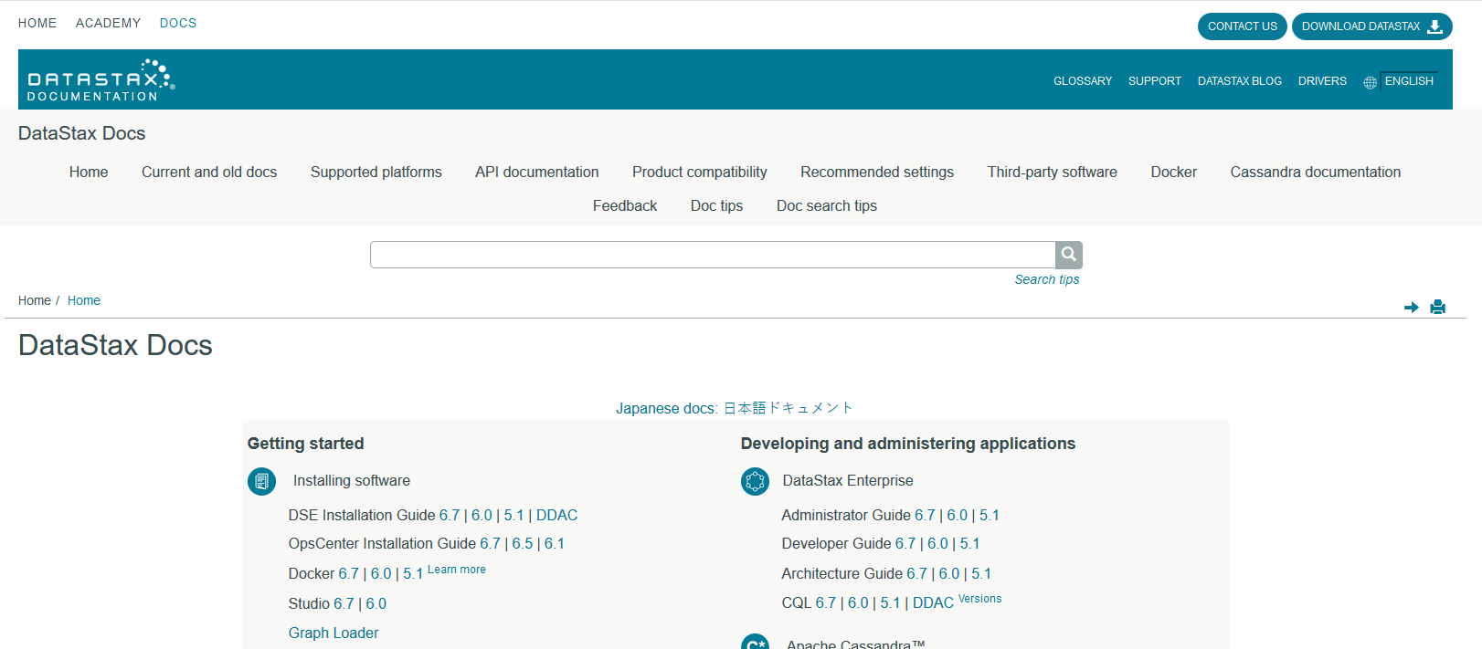
https://docs.datastax.com/en/landing_page/doc/landing_page/current.html

Slide 59
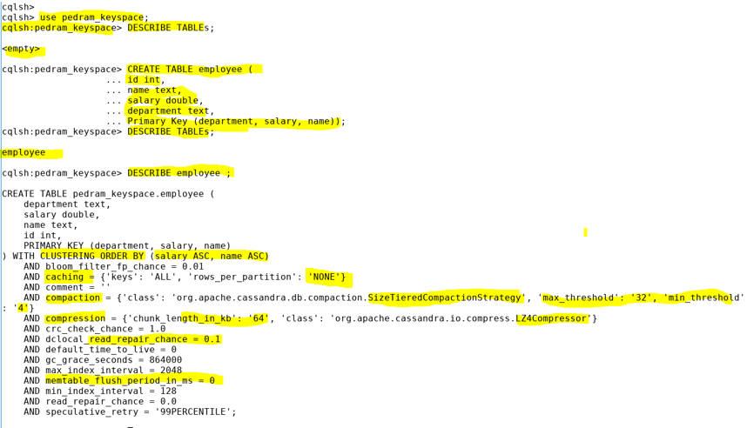
Notes:
First key is partition key then cluster key
Within each partition it will be ordered by salary then name (for each salary will be ordered by name)
Bloom_filter_fp_chance = 0.1 (its probability number )
caching = {'keys': 'ALL', 'rows_per_partition': 'NONE’} : it caches the keys per partition ? Its none
comment = ‘’ : you put comment for this table
compaction = {'class': 'org.apache.cassandra.db.compaction.SizeTieredCompactionStrategy', 'max_threshold': '32', 'min_threshold': '4’} Apply to sstable .
It merger small SSTable to one large file and remove those small files so it makes it faster . 4 , 32 are number of sstable
compression = {'chunk_length_in_kb': '64', 'class': 'org.apache.cassandra.io.compress.LZ4Compressor’}:
memtable_flush_period_in_ms = 0 : clear the memtble immediately (0)

Slide 60
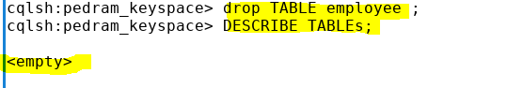



Slide 61


Slide 62


know your query before you design the DB .you should know enough . so you will know your partition key so it will be beneficial

Slide 63

Partition key
Clustering key
In each department your data will be sorted based on salary (DESC) and within each salary data will be sorted by name ( ASC)
Notes:
Clustering key orders data based on partition key

Slide 64

Why we should have a clustering key ?
If you want to retrieve data you can use where but if you want to retrieve more you can retrieve it if your data is sorted.
So we should know how to query data before we design our DB.
Notes:
IT AND HR ARE DIFFERENT PARTITION

Slide 65

In Cassandra your “where” clause must contain the partition key and all clustering key

Slide 66
Special Columns - Counter
Special purpose column to keep count
Cannot be mixed with regular columns
Needs dedicated counter tables
Only updates & reads are allowed on counter tables
Since Cassandra makes sure read consistency before an update, a counter table can have a consistency value of ONE
When you want to keep the sequence you use counter .Only in Cassandra not in SQL
Notes:
Example:
create table tweets_count (user varchar PRIMARY KEY, tweets counter);
update table tweets_count set tweets = tweets + 20 where user = ‘xyz_user’;
When you want to keep the sequence you use counter .Only in Cassandra not in SQL

Slide 67


Slide 68


you can not do that for employee because your id is not id counter

Slide 69
Expiring Columns - TTL
Keyword used is TTL (Time to Live)
Applied on rows of columns that should be automatically deleted after a fixed time.
Specified in seconds, the smallest interval being 1 second.
Candidate row/column is marked for removal & removed during the next compaction/read repair.
TTL can be changed by updating the column.
TTL can be removed by setting t to 0 before the TTL expires.

Slide 70

Query Immediately
Query after 30 seconds
Query before 60 seconds
Notes:
Query Immediately

Slide 71



Slide 72

Columns level TTL:

Slide 73

Data Types
Please refer to the following link to the Datastax Cassandra site:
http://docs.datastax.com/en/cql/3.1/cql/cql_reference/cql_data_types_c.html

Slide 74
Index
Queries on non primary keys do not work in Cassandra
For such queries to work, such columns should be indexed
Create Syntax: CREATE INDEX name ON table(column);
Avoid high cardinality columns for indexes
Very low cardinality columns may not be useful
Frequently updated or deleted columns should not be indexed
Drop Syntax: DROP INDEX [ IF EXISTS ] index_name;

Slide 75
Table Properties
Property | Syntax | Description
bloom_filter_fp_chance | bloom_filter_fp_chance = int_between_0_and_1 | Specifies the probability of getting false positive result during a read operation
caching | caching = { 'keys' : '{NONE|ALL}', 'rows_per_partition' : '{NONE|ALL|positive_int}' }; | By default key caching is enabled at the cluster level. Use this property to specify table specific caching.
ce –– The syntax is

Slide 76
Table Properties
Property | Syntax | Description
comment | comment = some_string | Comment about the table
compaction | COMPACTION = {'class': compaction_strategy, 'tombstone_compaction_interval': positive_integer, 'tombstone_threshold': integer_between_0_and_1}; | Describes the compaction strategy. The properties are: enabled tombstone_threshold tombstone_compaction_interval unchecked_tombstone_compaction min_sstable_size min_threshold max_threshold bucket_high bucket_low cold_reads_to_omit sstable_size_in_mb
ce –– The syntax is

Slide 77
Table Properties
Property | Syntax | Description
compression | COMPRESSION = {'sstable_compression': compression_algorithm, 'chunk_length_kb': positive_integer}; | Specifies the data compression parameters on the disk. The compressors provided are: LZ4Compressor SnappyCompressor DeflateCompressor
crc_check_chance | crc_check_chance = Integer_between_0and_1; | This property tells the probability by which reads are verified for any errors. By default, it is set to 1, so all reads are first validated for data integrity. If it is set to 0.25, every fourth read is validated.
ce –– The syntax is

Slide 78
Table Properties
Property | Syntax | Description
default_time_to_live | default_time_to_live = inetger_0_or_greater | Default TTL for all rows in the table.
read_repair_chance | read_repair_chance = Int_between_0_and_1 | Specifies the probability of performing a repair (making all replicas consistent) only in the data center that received the read request. If it is set to 0.25, every fourth read request will sync the whole data center.
gc_grace_seconds | gc_grace_seconds = num_of_seconds | Time till rows/columns are marked with tombstones but not yet removed.
ce –– The syntax is

Slide 79
Table Properties
Property | Syntax | Description
max_index_interval & min_index_interval | integer | Specifies the maximum & minimum sample index interval in memory.
memtable_flush_period | Integer_in_milliseconds | Represents the number of milliseconds after which a Memtable is forced to be flushed to the disk. The default is zero.
speculative_retry | speculative_retry = {ALWAYS| X percentile | X milliseconds | NONE} | This coordinator node avoids read node failure by sensing the unusual delay that the replica takes and retries on a different replica.
ce –– The syntax is

Slide 80
Install Cassandra in Windows

Slide 81

Step :1 – Setting up Jdk and Python

Slide 82

Step :2 – Setting up the env path

Slide 83

Step :3 – Start Cassandra Server (-f = in foreground)
Apache Cassandra 3.11.4 ( Link )

Slide 84

Step :4 – Setting cluster Information (using nodetool)

Slide 85

Step :5 - Creating a Table into Database

